Slide 1
Day 6

Slide 2
Objectives
Byte Streams vs Characters Streams Reading & Writing files
Reading & Writing buffers
Serialization and Deserialization

Slide 3
File Handling
In Java, a File is an abstract data type. A named location used to store related information is known as a File. There are several File Operations like creating a new File, getting information about File, writing into a File, reading from a File and deleting a File.
Stream
A series of data is referred to as a stream. In Java, Stream is classified into two types, i.e., Byte Stream and Character Stream.

Slide 4
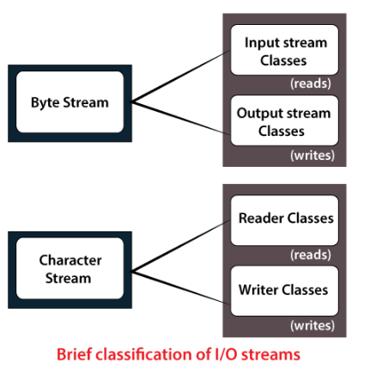
File Handling

Slide 5
Byte Streams vs Characters Streams
Byte Stream | Character Stream
Byte handle data in bytes(8 bits) | Character handles data in 16 bit Unicode
Common classes are FileInputStream and FileOutputStream | Common classes FileReader FileWriter
Works with non-character data(i.e works characters, videos, images etc) | Work with character data. (i.e works text data only)

Slide 6
Byte Streams vs Characters Streams
Byte Stream
Byte Stream is mainly involved with byte data. A file handling process with a byte stream is a process in which an input is provided and executed with the byte data.
Character Stream
Character Stream is mainly involved with character data. A file handling process with a character stream is a process in which an input is provided and executed with the character data.

Slide 7
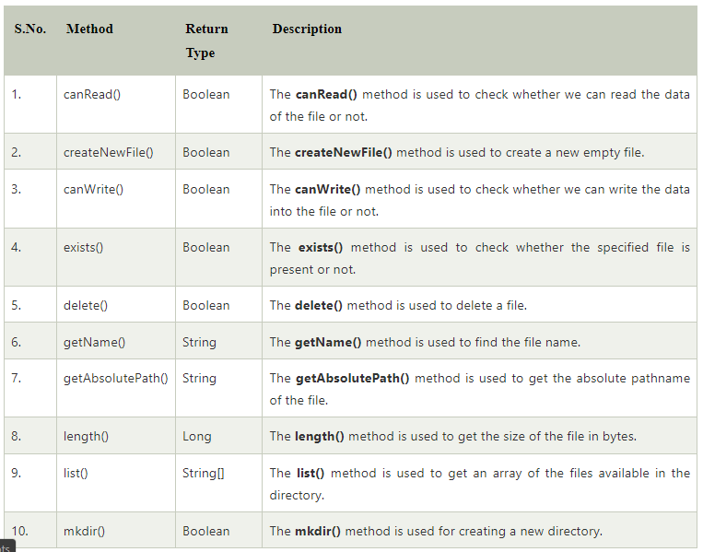
Java File Class Methods

Slide 8
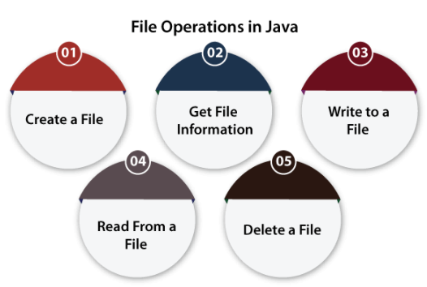
File Operations

Slide 9
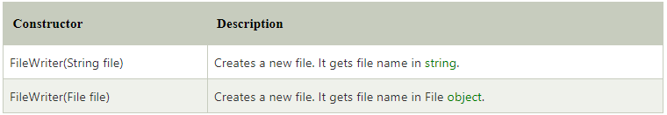
Java FileWriter Class
Java FileWriter class is used to write character-oriented data to a file. It is character-oriented class which is used for file handling in java.
Constructor -

Slide 10
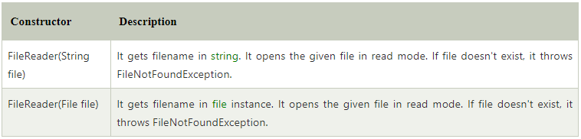
Java FileReader Class
Java FileReader class is used to read data from the file. It returns data in byte format like FileInputStream class.
It is character-oriented class which is used for file handling in java.
Constructors of FileReader class

Slide 11
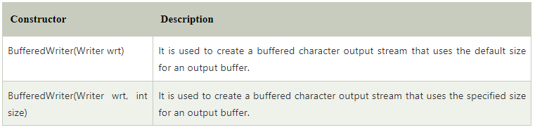
Java BufferedWriter Class
Java BufferedWriter class is used to provide buffering for Writer instances. It makes the performance fast. It inherits Writer class. The buffering characters are used for providing the efficient writing of single arrays, characters, and strings.
Constructor

Slide 12
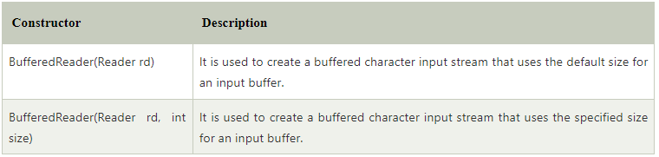
Java BufferedReader Class
D1-9
Java BufferedReader class is used to read the text from a character-based input stream. It can be used to read data line by line by readLine() method. It makes the performance fast. It inherits Reader class.

Slide 13
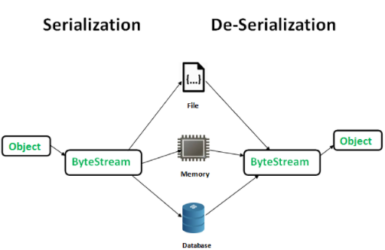
Serialization and Deserialization in Java
Serialization is a mechanism of converting the state of an object into a byte stream. Deserialization is the reverse process where the byte stream is used to recreate the actual Java object in memory. This mechanism is used to persist the object.

Slide 14
Serialization and Deserialization in Java
The byte stream created is platform independent. So, the object serialized on one platform can be deserialized on a different platform.
To make a Java object serializable we implement the java.io.Serializable interface. The ObjectOutputStream class contains writeObject() method for serializing an Object.
The ObjectInputStream class contains readObject() method for deserializing an object.
D10

